Slide 1
What and How Children Search on the Web
Author : Sergio Duarte Torres, Ingnar Weber
Source : CIKM’11
Advisor : Dr. Jia-Ling Koh
Speaker : I-Chih Chiu

Slide 2
Outline
Introduction
Data Set and Methodology
Search Difficulty
Tracing Children Development Stages
Conclusion

Slide 3
Introduction
83%
76%
63%

Slide 4
Introduction
What is love?

Slide 5
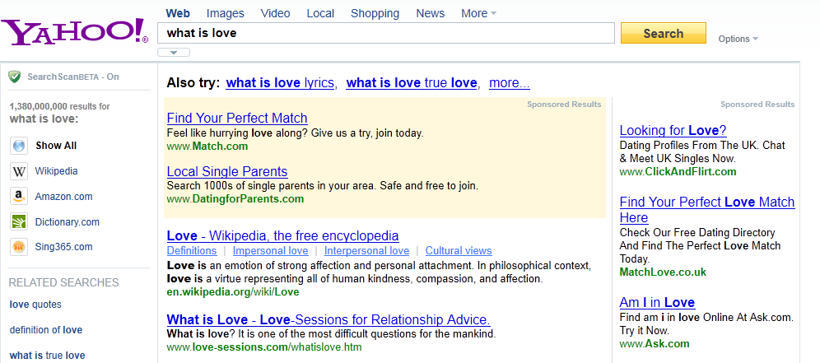
Introduction

Slide 6
philosophical context
Canonical gospels
interpersonal attraction
interpersonal relationships
psychological importance
Notes:
we observed that young users have a tendency to click on higher ranked results, spend short time on each url and in general have shorter sessions than those observed in older users.

Slide 7
Introduction
Goal
Identify and quantify search struggle of young users.
Retrace stages of child development through their web searches.

Slide 8
Outline
Introduction
Data Set and Methodology
Search Difficulty
Tracing Children Development Stages
Conclusion

Slide 9
Data Set
The Yahoo! search logs from May to August of 2010
To filter out search log data
Log entries of users
Without a valid Yahoo! Account
With unspecified birth year, gender and zip code in the profiles
Queries
Contain personally identifiable information
Be issued by only a single user
Non alpha-numerical single token

Slide 10
Data Set
Size
 | Below 10 years old | Above 10 years old
Volume of queries | >100K | >1M
Number of users | >10K | >100K

Slide 11
Data segmentation
Users aggregated based on their reported birth year
Age estimated as : (2010 – Birth year)
Following age buckets were created:
6-7: early elementary
8-9: children
10-12: old children
13-15: teenagers
16-18 : old teenagers
>18: adults

Slide 12
Methodology
Micro-Average vs. Macro-Average
User A User B User C
50x i-phone 2x i-phone 1x i-phone
5x HTC 5x HTC 10x HTC
People search mostly for i-phone. True? False?
Micro average : i-phone = (50+2+1)/(50+5+2+5+1+10) = 0.726 HTC = 0.274
Macro average : i-phone = (50/55 + 2/7 + 1/11) / 3 = 0.428 HTC = 0.572

Slide 13
Methodology
Detecting Navigational Queries
Editorial judgments
Ask human judges to mark queries a navigational
Click entropy
Look at the diversity of the results clicked in response
Be judged as navigational → click entropy ≤ 1.0
String similarity heuristics
Try to find query as substring in clicked domain

Slide 14
Outline
Introduction
Data Set and Methodology
Search Difficulty
Tracing Children Development Stages
Conclusion

Slide 15
Search Difficulty Online
Pose longer queries
Use natural language
Click position bias
Have more “long” clicks
Click on ads
Rely on search suggestions
Children expose to adult content

Slide 16
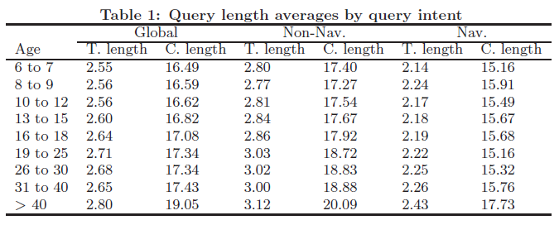
Pose longer queries
Token length and character length
Notes:
Query length has also been associated to the specificity of the user’s query intent, longer queries representing more specific and less ambiguous information needs.

Slide 17
Use natural language (I)
Question queries
what is the only immortal animal?
Modal queries
I don’t want to go to school
Knowledge questions
Describe the parts of a cell
Contain the words : describe, about, explain, define
Superlative queries
the fastest dog
Targeted queries for kids
car photos for kids

Slide 18
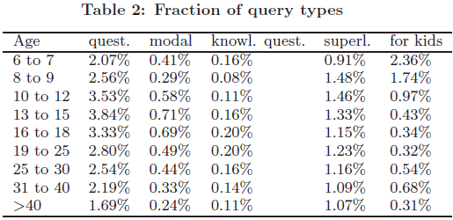
Use natural language (II)

Slide 19
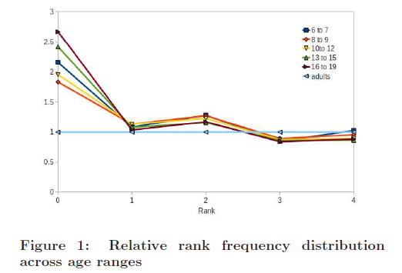
Click position bias

Slide 20
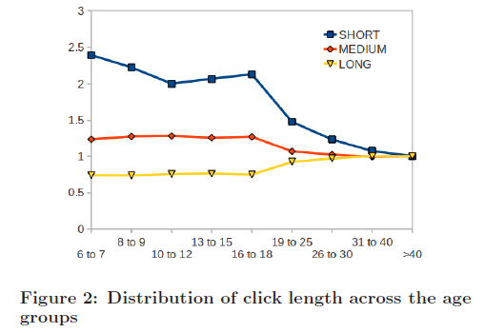
Have more “long” click
short (0-10 seconds)
medium(11-99 seconds)
long (≥ 100 second)
Notes:
Here a long click is a click on a result such that after the click the user does not issue a new query or click on another result for at least 100
seconds.

Slide 21
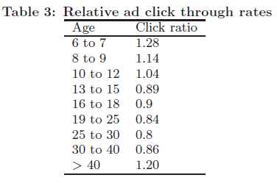
Click on ads

Slide 22
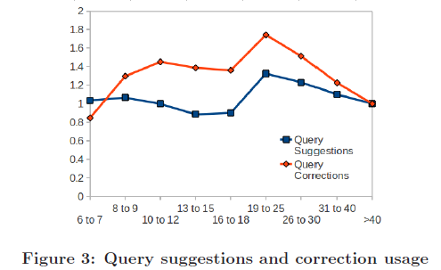
Rely on search suggestions

Slide 23
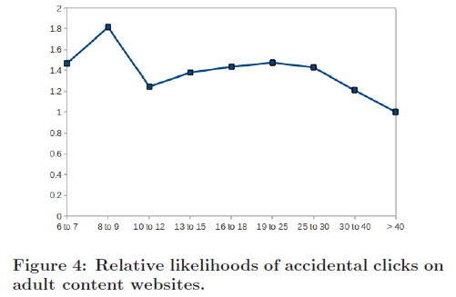
Children exposed to adult content

Slide 24
Outline
Introduction
Data Set and Methodology
Search Difficulty
Tracing Children Development Stages
Conclusion

Slide 25
What do children search for
Children and teenager groups have few dominant topics
Also due to smaller vocabulary
Adults have more diverse query topics

Slide 26
Gender differences (I)
Topic distribution per each group and gender
1-Norm to quantify gender differences
Example for age group 10-12
|$\left|{dif}_{10−12}|\right|=|(x{}_{1}^{m}−x{}_{1}^{f})|+|(x{}_{2}^{m}−x{}_{2}^{f})|+.…+|(x{}_{n}^{m}−x{}_{n}^{f})$|
$${where x}_{i}^{m} is the probability of a male user aged$$
$$10−12 searching for topic x_{i}$$
x₁ : Games , x₂ : computer & internet , x₃ : movies $\left|\left|{dif}_{10−12}\right|\right|=\left|0.5−0.2\right|+\left|0.6−0.4\right|+\left|0.2−0.5\right|=0.8$

Slide 27
Gender differences (II)

Slide 28
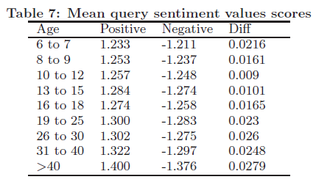
Do children express stronger sentiments in their queries
Positive & negative score (+1~+5)/(-1~-5)
“love” : (+3/-1), “stink” : (+1/-3)
“really love” : (+4/-1)
They issue different length queries (see Table 1)

Slide 29
Outline
Introduction
Data Set and Methodology
Search Difficulty
Tracing Children Development Stages
Conclusion

Slide 30
Conclusion
Clear behavioral differences between children and adults
Although not clean between teenagers and children
Sudden jump to adulthood from 19 to 25 years old
Stronger position click biased for children, including ads
Their hope is that a deeper understanding of children’s search behavior and their struggles will lead to a reduction of the prevalent “one size fits all” search interface.

